Slide 1
Parallel Simulations using Simulink
Dr Kameswarie Nunna
Academic Technical Specialist

Slide 2
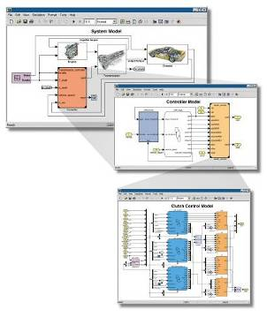
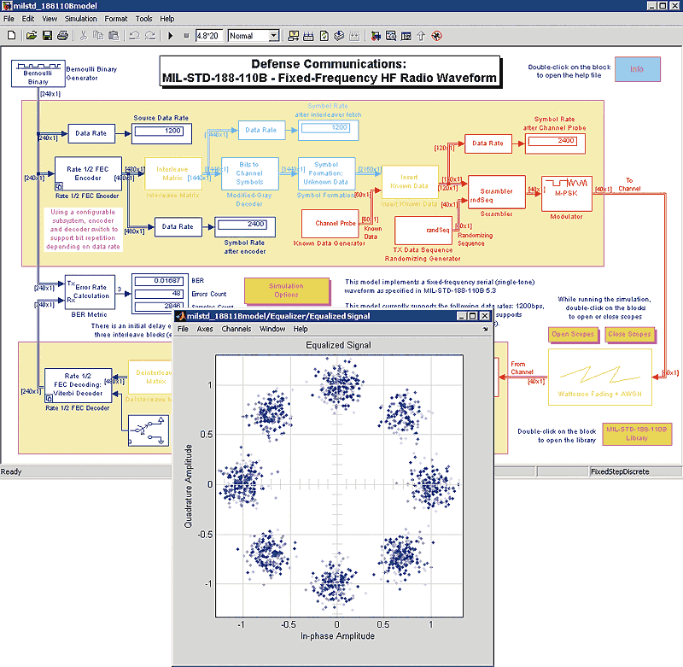
Introduction to Simulink®
Block-diagram environment
Model, simulate, and analyze multidomain systems
Accurately design, implement, and test:
Control systems
Signal processing systems
Communications systems
Other dynamic systems
Notes:
First lets introduce Simulink and what it can do.
Simulink is a Block-diagram environment
Where you can model and simulate dynamic, linear, nonlinear systems.
It lets you accurately design, implement, and test:
Control systems
Signal processing systems
Communications systems
And other time-varying systems
We can talk about Simulink both as a product and within the context of other tools that use Simulink as a platform for Model-Based Design. Lets make that distinction now, by first discussing the key features of Simulink the product.

Slide 3


MATLAB vs Simulink
Data Analysis
Visualization
Application Development
Algorithm Development
Application Deployment

Slide 4
MATLAB vs Simulink
Dynamic System Modelling
Signal, Image & Video Processing
Control System Development
Code Generation, Real-Time
Nonlinear, Multi-Domain Simulations

Slide 5
MATLAB & Simulink
Data Analysis
Visualization
Application Development
Algorithm Development
Application Deployment
Dynamic System Modelling
Signal, Image & Video Processing
Control System Development
Code Generation, Real-Time
Nonlinear, Multi-Domain Simulations

Slide 6
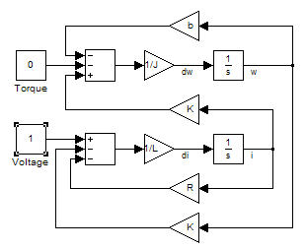
Modelling Dynamical Systems and parallel “for”
$$V=Kω+Ri+L\frac{di}{dt}$$
$$T=Ki−bω−\frac{Jdω}{dt}$$
First-Principles Modelling
Use an understanding of the system’s physics to derive a mathematical representation
V+
V-

